Slide 1
Unit-5
Controllers in Angular JS

Slide 2
What is Controller in AngularJs?
A Controllers in AngularJs takes the data from the model , processes the data, and then sends that data across to the view which is displayed to the end user. The Controller will have your core business logic.
The controller will use the data model, carry out the required processing and then pass the output to the view which in turn is displayed to the end user.

Slide 3
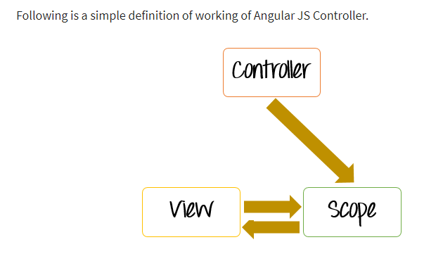
What Controller does from Angular's perspective

Slide 4
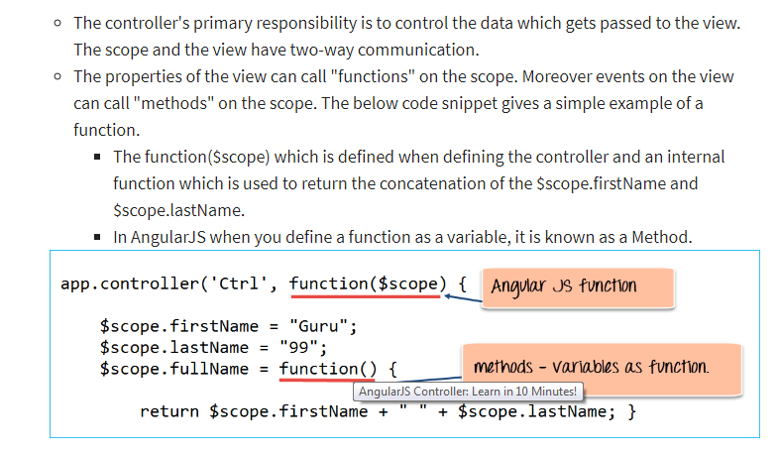

Slide 5
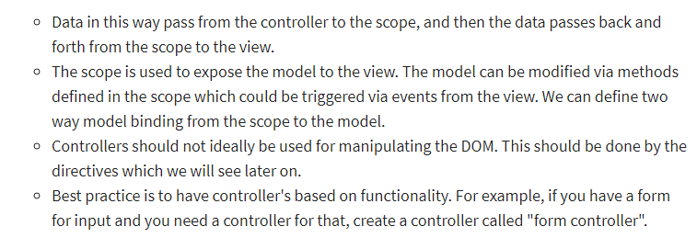

Slide 6
How to define Methods in Controller?
Normally, one would want to define multiple methods in the controller to separate the business logic.
For example, suppose if you wanted to have your controller do 2 basic things,
Perform the addition of 2 numbers
Perform the subtraction of 2 numbers
You would then ideally create 2 methods inside of your controller, one to perform the addition and the other to perform the subtraction.

Slide 7
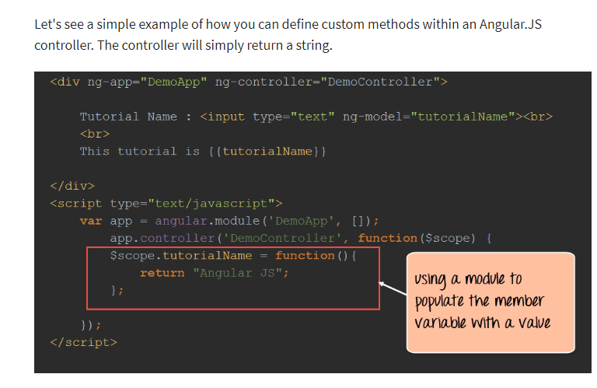

Slide 8
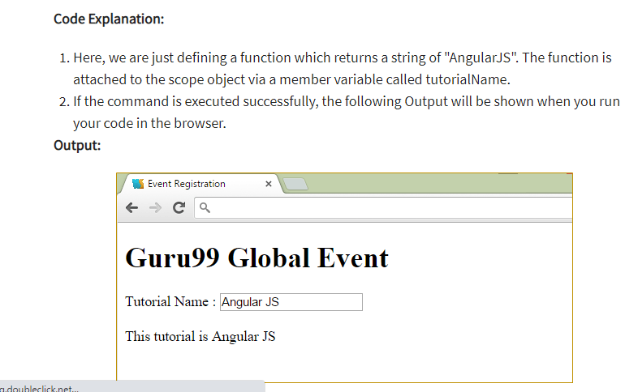

Slide 9
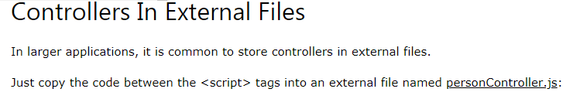
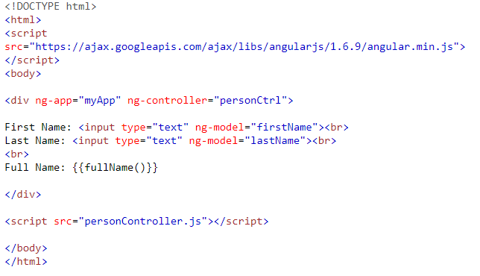
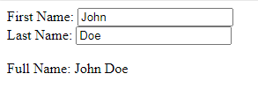
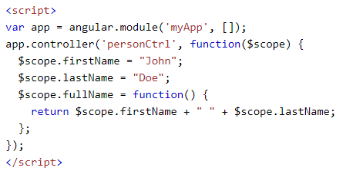
Output
External Script File

Slide 10
Angular JS Scope
The scope is a JavaScript object with properties and methods, which are available for both the view and the controller.
The scope is the binding part between the HTML (view) and the JavaScript (controller).
The scope is an object with the available properties and methods.
The scope is available for both the view and the controller.

Slide 11
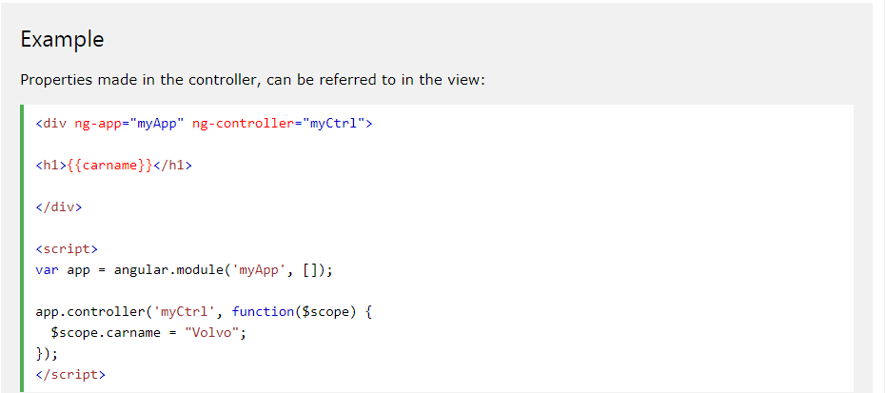
How to Use the Scope?
When you make a controller in AngularJS, you pass the $scope object as an argument:

Slide 12
Root Scope
All applications have a $rootScope which is the scope created on the HTML element that contains the ng-app directive.
The rootScope is available in the entire application.
If a variable has the same name in both the current scope and in the rootScope, the application uses the one in the root scope.

Slide 13
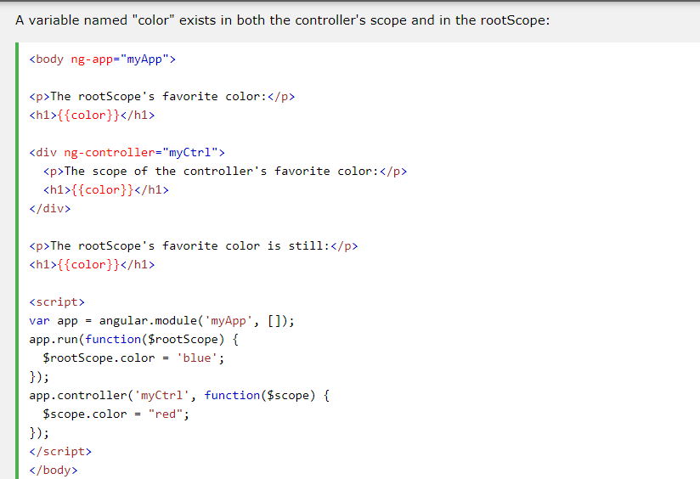
Notes:
Output
The rootScope's favorite color:
blue
The scope of the controller's favorite color:
red
The rootScope's favorite color is still:
blue
Notice that controller's color variable does not overwrite the rootScope's color value.

Slide 14
AngularJS Data Binding
Data binding in AngularJS is the synchronization between the model and the view.
So Data binding has two components.
Model
View

Slide 15
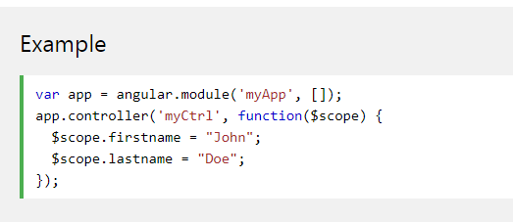
Model
AngularJS applications usually have a data model. The data model is a collection of data available for the application.

Slide 16
View
The HTML container where the AngularJS application is displayed, is called the view.
The view has access to the model, and there are several ways of displaying model data in the view.
You can use the ng-bind directive, which will bind the innerHTML of the element to the specified model property:

Slide 17
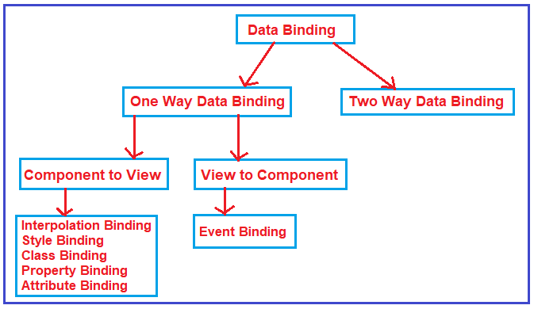
Typed Of Data binding

Slide 18
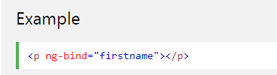
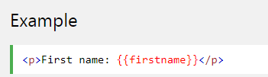
Different Ways of Binding
You can use the ng-bind directive, which will bind the innerHTML of the element to the specified model property:
You can also use double braces {{ }} to display content from the model:

Slide 19
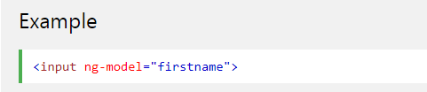
Different Ways of Binding
3. The ng-model Directive
4. Two-way Binding
Data binding in AngularJS is the synchronization between the model and the view.

Slide 20
Different Ways of Binding
What is 2 way binding?
When data in the model changes, the view reflects the change, and when data in the view changes, the model is updated as well. This happens immediately and automatically, which makes sure that the model and the view is updated at all times.

Slide 21
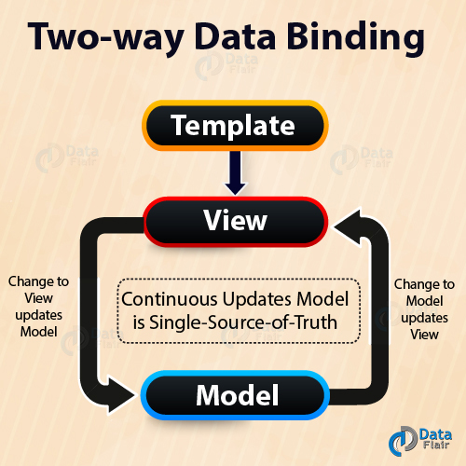

Slide 22
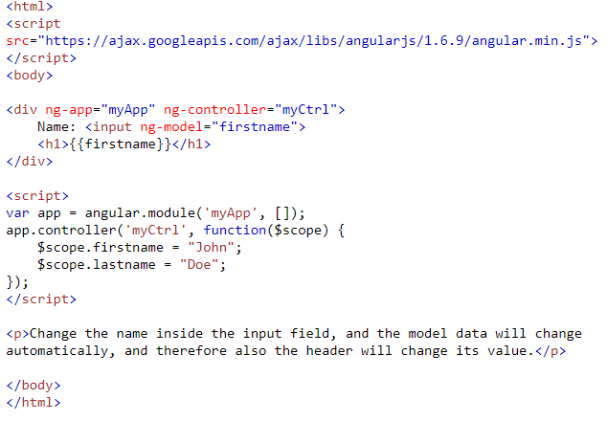
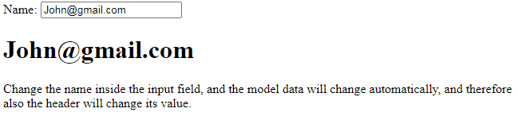
Example of 2 Way Binding

Slide 23
Design Angular JS table
Sort the Data in Angular JS table

Slide 24
